Slide 1

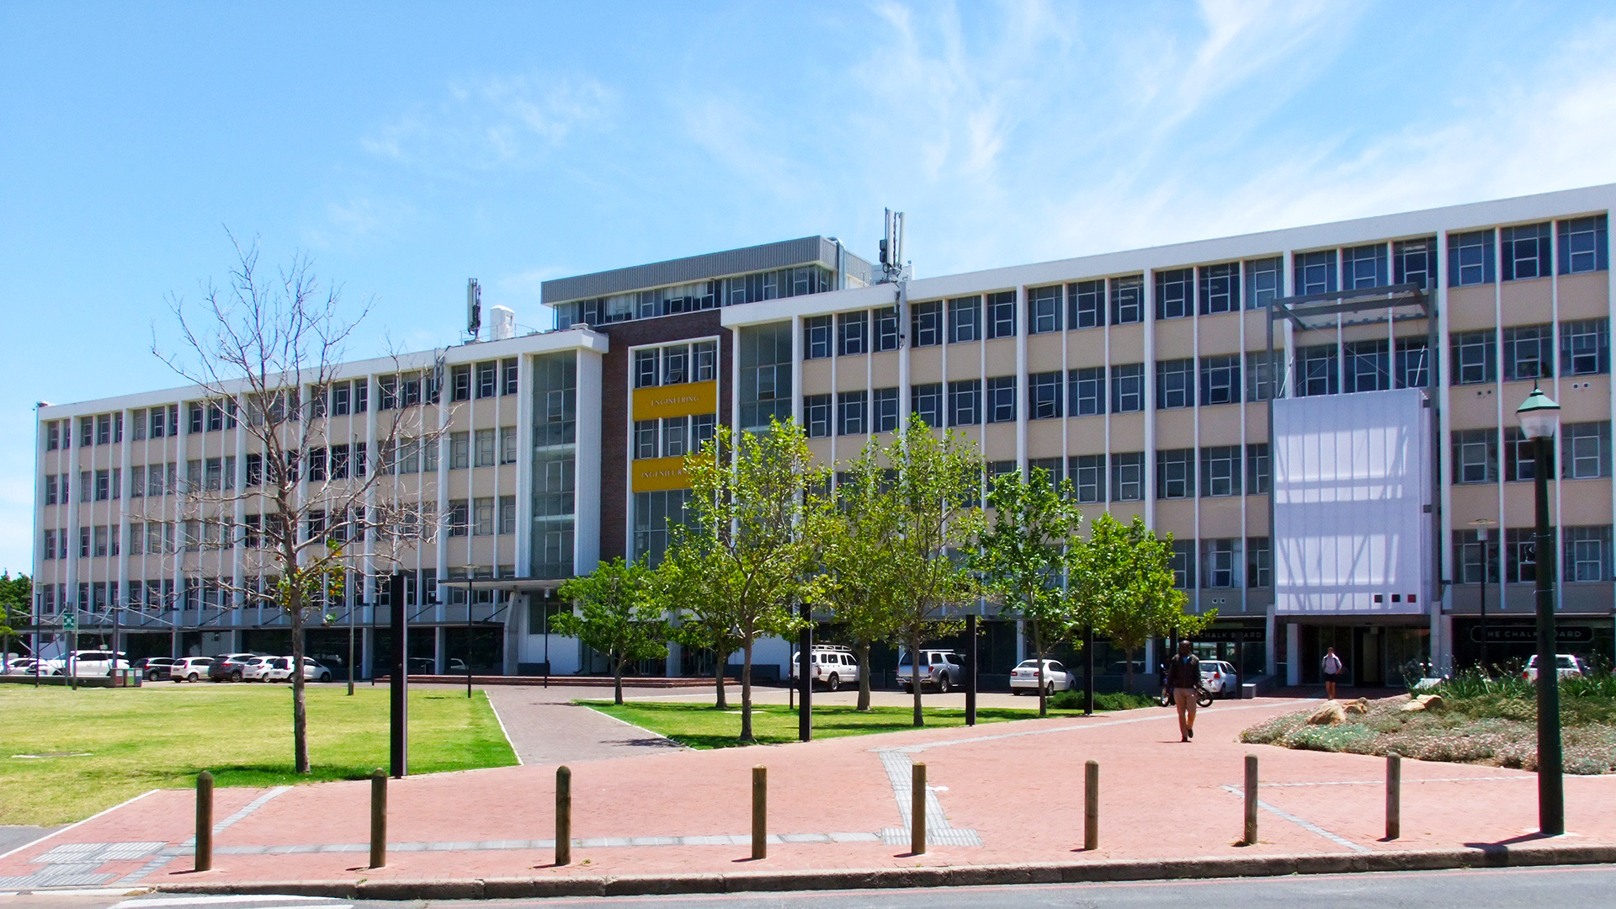

Practical 3: Elements to Minerals Conversion
Photo by Stefan Els
Notes:
Hi everyone ,welcome to this short practical session on Elements to Minerals Conversion.
In the previous session, you looked at sampling and characterisation. Now we’re going to use some of that information — specifically the assay data — to estimate how much of each mineral is present in an ore sample.
Before we dive in, let me quickly go over the learning outcomes for this session.

Slide 2

Outcomes
The outcomes of this topic include:
Identify the primary minerals associated with specific elements in ore samples.
Relate elemental assay data to mineralogical composition.
Convert elemental concentrations (from XRF, ICP-MS, or other techniques) into mineral abundances.
Use stoichiometric calculations to estimate mineral proportions.
Understand the limitations of element-to-mineral conversions based on analytical uncertainties.
Slide 2
Notes:
Image sources, check all slide numbers throughout.

Slide 3
Elements to Minerals Conversion
For simple ores comprising only one or two valuable minerals associated with a diagnostic element, the mineral grades can be calculated from known mineral compositions (measured using EPMA ) or from stoichiometric mineral compositions.
A × X = b
A represents the fraction of element in the mineral,
X is the wt.% of the mineral in the sample (mineral grade)
b is the wt.% of the element in the sample (element grade).
This approach however relies on prior knowledge of which valuable minerals are present and although elegant, should be handled with care
Notes:
We’ll be using a basic manual method based on this formula: A × X = b.
This method works well when you’re dealing with simple ore systems. maybe one or two valuable minerals tied to a diagnostic element. You just need to know which minerals are present and the element proportions within them.
For today, we’re working with simplified assay data, just to get a feel for the method. You’ll see a worked example first, which we’ll go through together. Then I’ll give you a short exercise using a similar data table so you can try it out yourselves.
Just to set expectations — this is the foundation. In real-world work, things are rarely this tidy. Assay data often reflects overlapping mineral phases, impurities, or uncertainty in both measurement and interpretation. Later in the course, when we get to data modelling, you ll be working with more realistic datasets and digital tools. But for now, let’s focus on the fundamentals and make sure we understand how this basic conversion works.

Slide 4
Practical 3: Elements to Minerals Conversion
Example
Photo by Stefan Els

Slide 5
Elements to Mineral Conversion - Example
Given that a sulphide ore composed of the following minerals and elemental composition/grade assays (Weight %) :
🔸 What is the percent of bornite, millerite, and pyrite in the ore? Practical 3_Example and Exercise_Final
Mineral | Formula
Bornite | Cu₅FeS₄
Millerite | NiS
Pyrite | FeS₂
Element | Wt. % | Molar Mass (g.mol-1)
Cu | 2.10 | 63.55
Ni | 2.75 | 58.70
Fe | 60.30 | 55.85
S | 34.85 | 32.07
Slide 2
Notes:
Image sources, check all slide numbers throughout.

Slide 6
Practical 3: Elements to Minerals Conversion
Exercise
Photo by Stefan Els

Slide 7
Elements to Mineral Conversion - Exercise
Following the characterization of an ore a simplified version of the assay data is presented in Table 1. The mineralogical data is presented in Table 2. Based on this data, calculate the percentage of each mineral in the ore sample.
Table 1: Chemical assay data of the ore sample.
Table 2: Mineralogical data of the ore sample.
Mineral | Formula | Molar mass (g/mol)
Chalcopyrite | CuFeS₂ | 183,52
Galena | PbS | 239,27
Sphalerite | ZnS | 97,46
Barite | BaSO₄ | 233,39
Pyrite | FeS₂ | 119,98
Magnetite | Fe₂O₃ | 159,69
Quartz | SiO₂ | 60,08
Element | Chemical assay (Wt. %) | Molar Mass (g.mol-1)
Si | 9,72 | 28,09
Fe | 18,89 | 55,85
S | 22,33 | 32,07
Cu | 11,76 | 63,55
Zn | 5,98 | 65,39
Pb | 8,72 | 207,2
Ba | 6,67 | 137,33
Slide 2
Notes:
Image sources, check all slide numbers throughout.

Slide 8


Thank you!
Photo by Stefan Els
Notes:
Thank you for listening.

